Slide 1
Network Coding

Slide 2
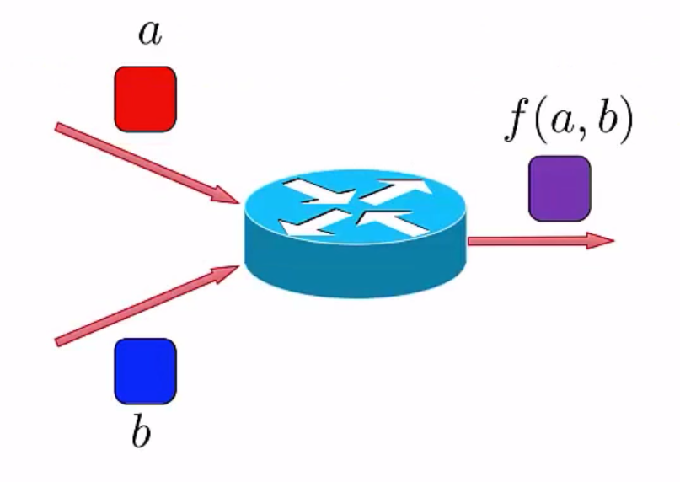
What is Network Coding?

Slide 3
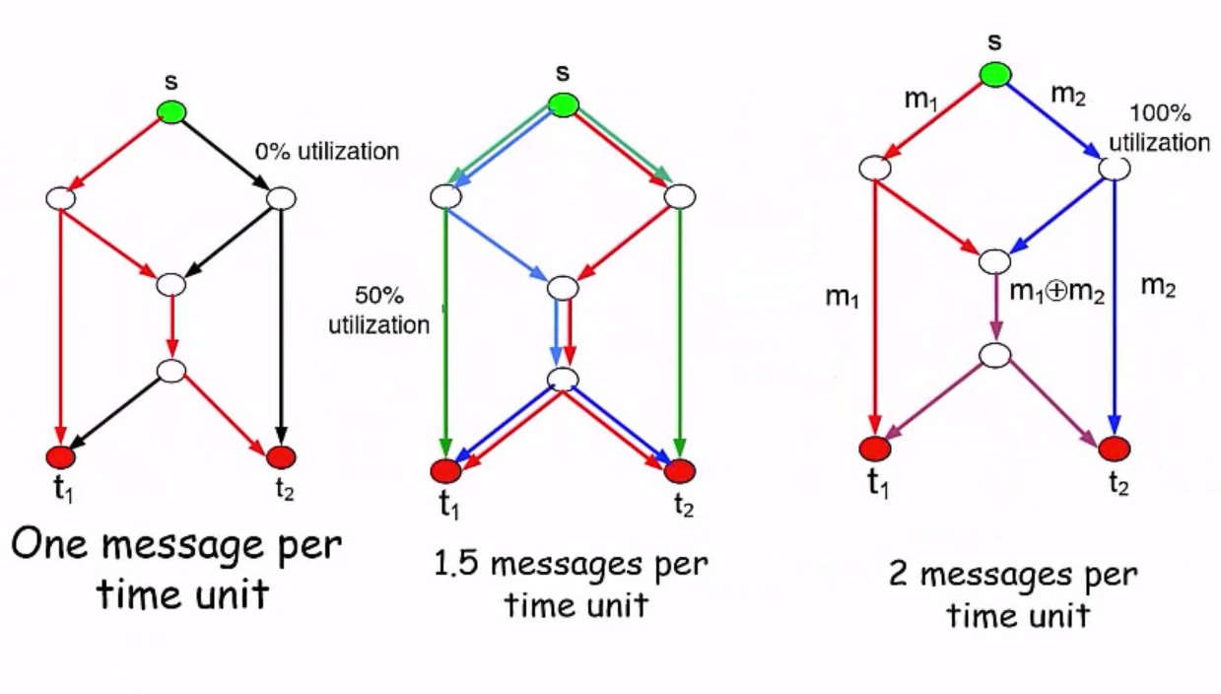

Slide 4
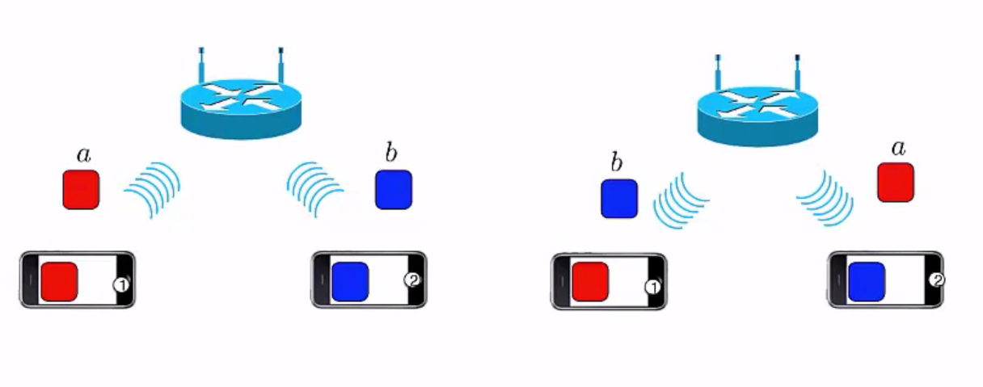
Wireless Coding

Slide 5
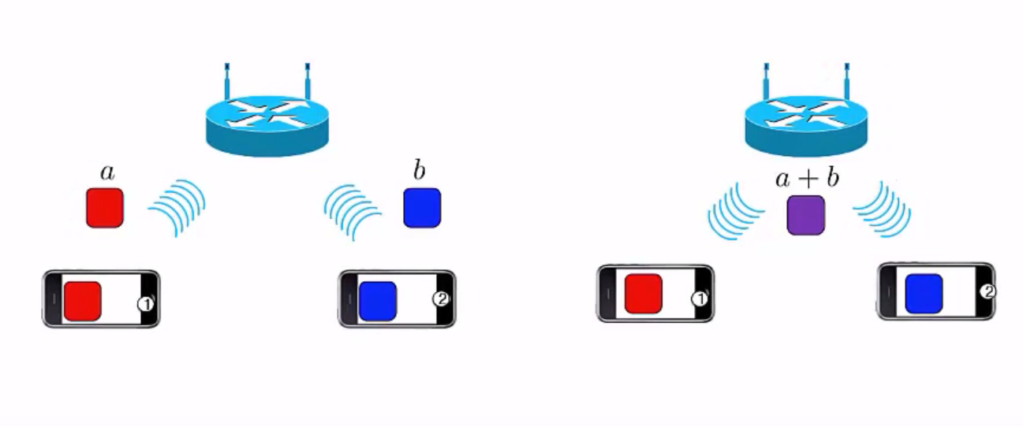

Slide 6
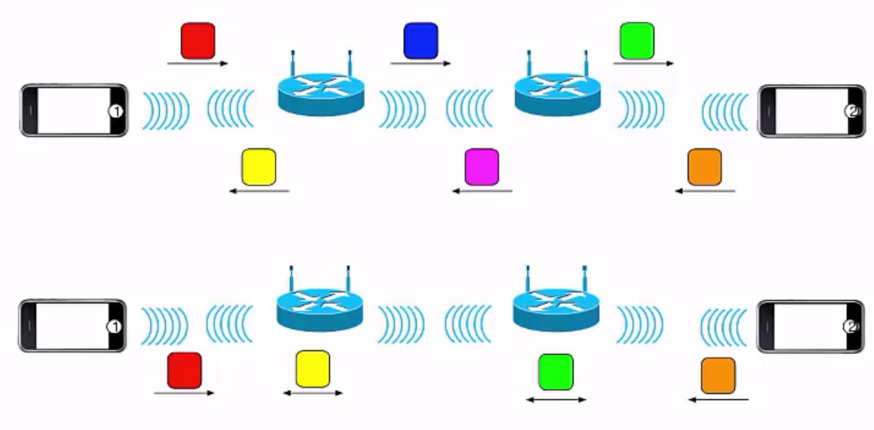
Reverse Carpooling

Slide 7
Combine incoming packets into one or many outgoing packets.
Goal
Increase throughput
Decrease Energy Consumption
Decrease Delay/Wait Time
Increase Reliability

Slide 8
Increased Throughput
Increase Information Content Of Transfers And Packets.
Decreases Number Of Transfers To Transfers to Carry Data to Multiple or Single Nodes.
This Makes Bandwidth available for other nodes to use
Delay is reduced drastically.

Slide 9
Flexibility
All packets become equally important as information gets disseminated.
Information can be retrieved by collecting enough number of packets regardless of which packets.

Slide 10
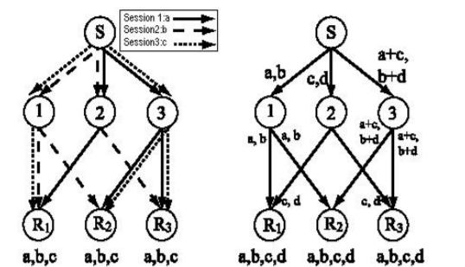
Not only the shortest path is used but also other paths are used to transmit the data.
The traffic in the network is distributed to multiple links and network coding can have an effect of load balancing.

Slide 11
Disadvantages
The loss of one packet could affect many other packets and renders some information useless at the receiver.
 Data cannot be recovered until all
the information necessary is received → Delay

Slide 12
Synchronization is a problem that needs to be considered when network coding will be implemented in computer or satellite networks.
It it can be a serious problem for real-time applications (e.g. voice and video transmission).
However, certain types of networks like switching networks are inherently fully synchronized. These types of networks are perfect candidates for the application of network coding.

Slide 13
Challenges
Further research problems in network coding include code construction when two or more sources are simultaneously multicast in the network. This is known as the multisource network coding problem which is yet unexplored.
Also, there is still a lot of research to do in the case of cyclic networks where so far the only codes created are time varying, which makes them less appealing in practice.
There is lots of room to incorporate security applications and network management applications in network coding which could lead to future networks which will be much more optimized and resource efficient.

Slide 14
In network coding, an intermediate node must wait for a number of packets so that they can be combined, increasing the latency of the first packet

Slide 15
Random Linear Network Coding
It is a simple yet powerful encoding scheme
broadcast transmission schemes allows close to optimal throughput using a decentralized algorithm
Nodes transmit random linear combinations of the packets they receive
Receiver solves the linear combinations it receiver to get its packet

Slide 16
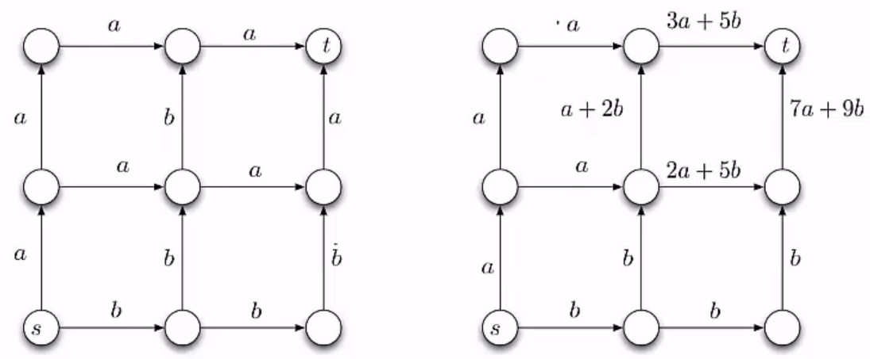
What if the number of packets received is insufficient to recover the original packets?
This can be addressed by sending additional random linear combinations until the receiver obtains the appropriate number of packets
Notes:
Global Topology and coordination
Encoding coefficients

Slide 17
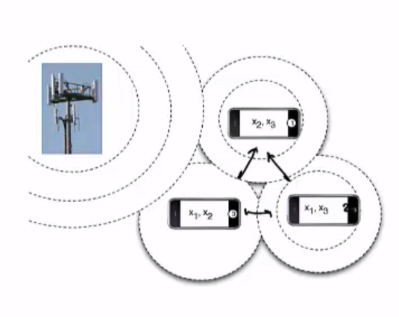
Heterogenous Wireless Networks
Clients may be interested in same data.
Data is broadcasted from an external source.
Clients receive missing packets from their peers using local links.

Slide 18
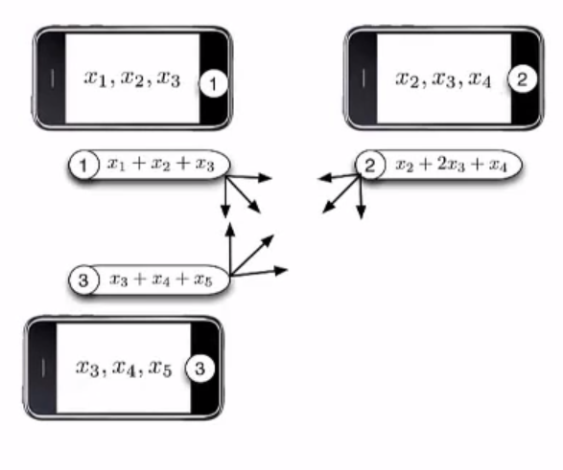
Cooperative Data Exchange

Slide 19
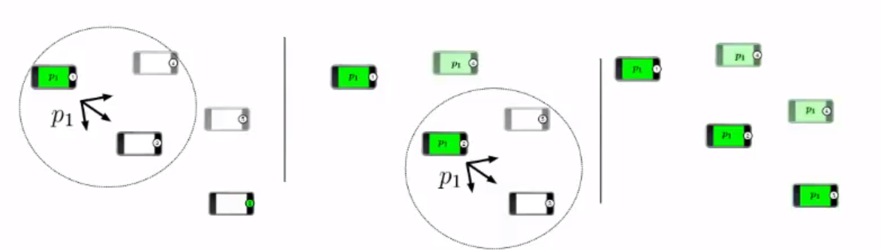
Index Coding
Works on the notion of side information.
Basically, information know to a node but not really required to the node.
This is due to the nature of the broadcast spectrum.

Slide 20
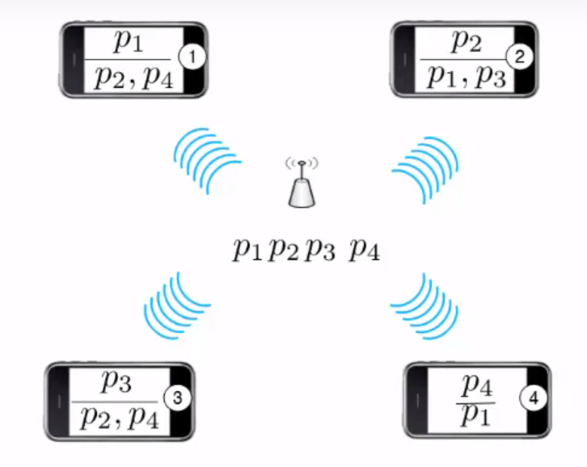

Slide 21
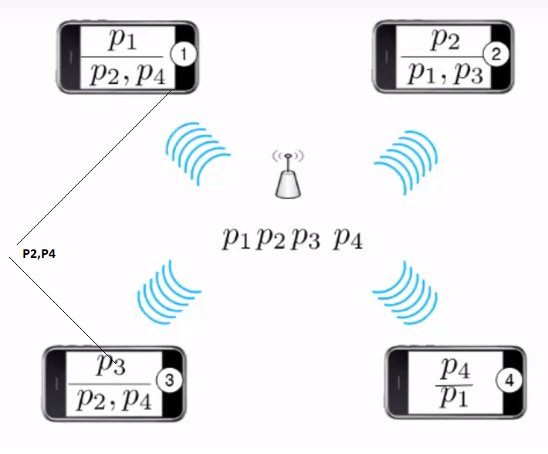

Slide 22
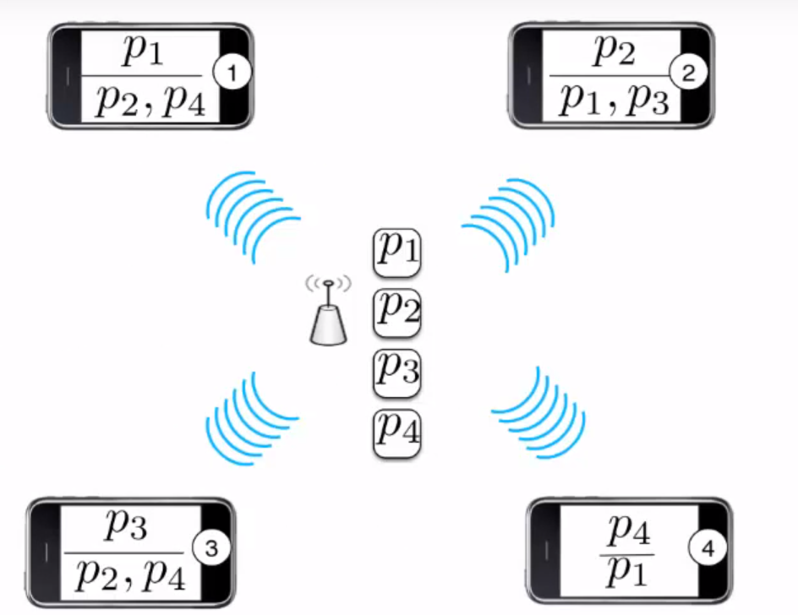

Slide 23
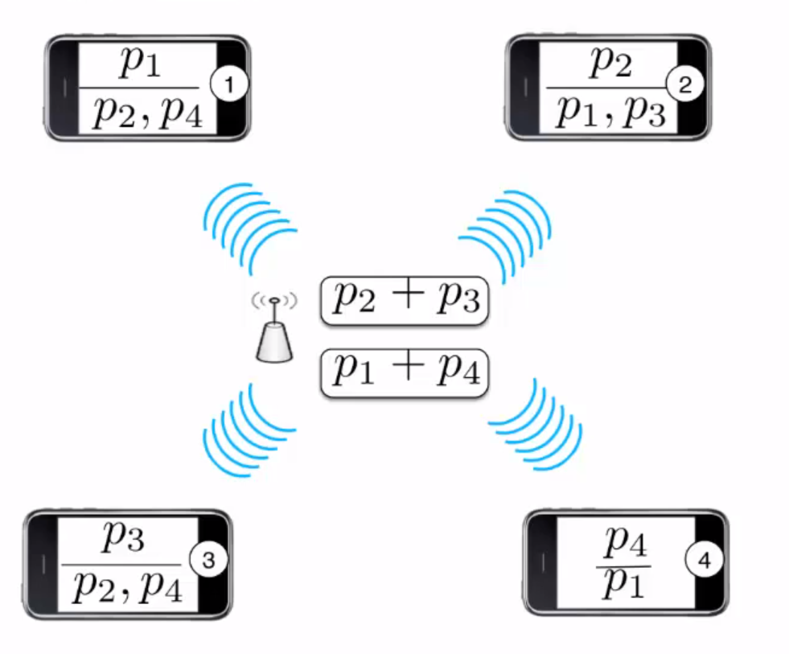

Slide 24
Multicast Communication
We want to transmit packets from a single source S to a set of terminal T ={t1,t2,….,tK}
Goal: To maximize rate of transmission between S and T.

Slide 25
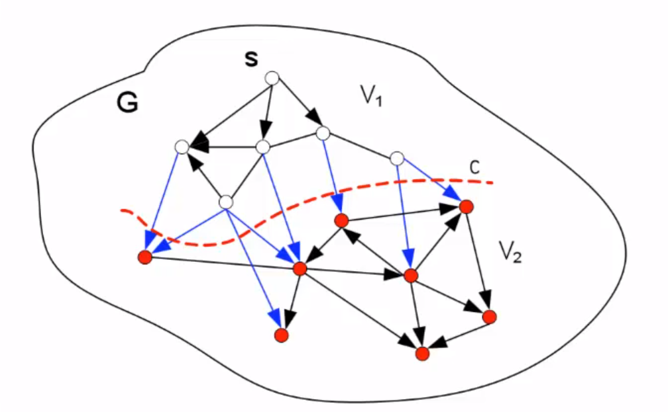
Cuts
A Cut is a partition of nodes into two subsets V1 and V2.
Size of Cut is total capacity of link between V1 and V2.
Maximum Value of the Network is equal to minimum value of the

Slide 26
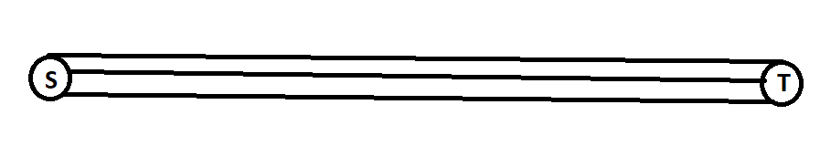
Menger’s Theorem
The following conditions are equivalent
It is possible to transmit h packets from s to t per time unit.
There are h edge-disjoint paths between s and t.
The minimum capacity that of a cut that separates s and t is h.

Slide 27
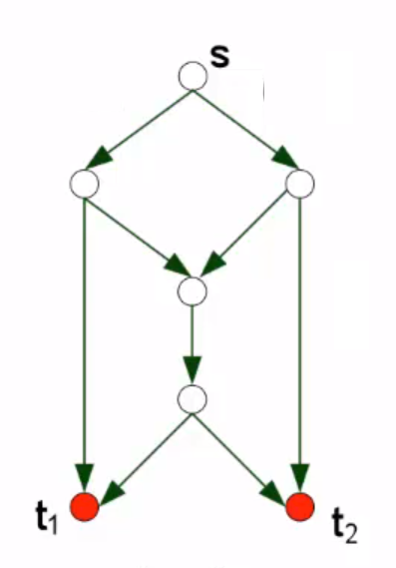
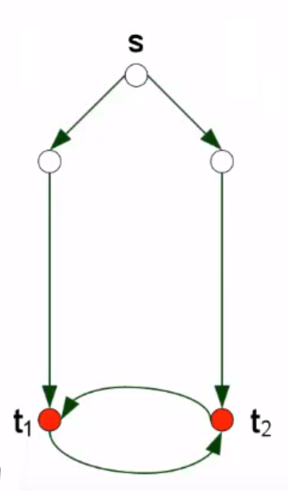
Cyclic Networks

Slide 28
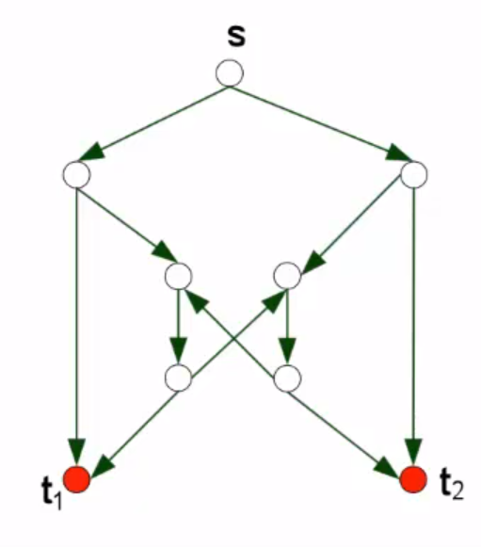

Slide 29
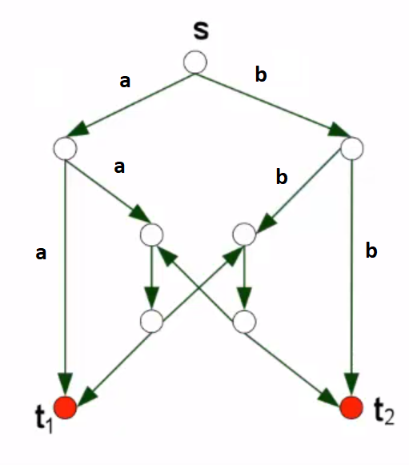

Slide 30
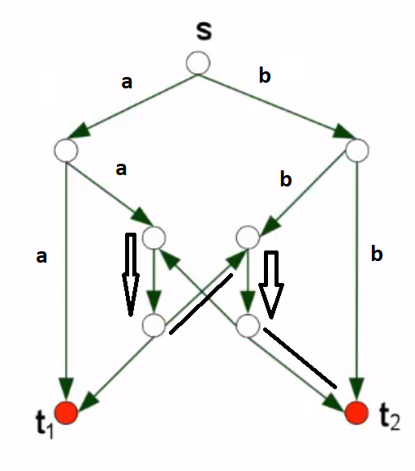

Slide 31
Applications!

Slide 32
P2P Networks
A server distributes a ﬁle by breaking it down into small blocks.
Clients in turns, download those small blocks from the server and distribute them among their neighbors.
Network coding has been used in a P2P prototype called Avalanche developed by Microsoft where the blocks sent by servers and clients are random combinations of original blocks.

Slide 33
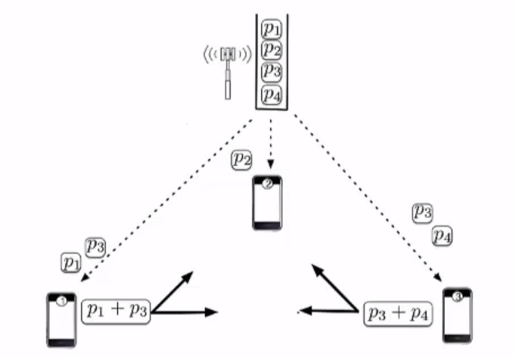
P2P Networks
Server divides files into smaller blocks. (B1,B2,B3,B4,…,Bn.)
Client now receives a linear combination of these blocks.
A coeﬃcient vector u is sent for the client to be able to decode the original blocks.

Slide 34
Every client sends a linear combination of blocks it has instead of raw blocks.
So, if a client is to send out the blocks E1 and E2 it has just received, the output block (E3) with be formed using
E3 = c3 1E1 + c3 2E2

Slide 35
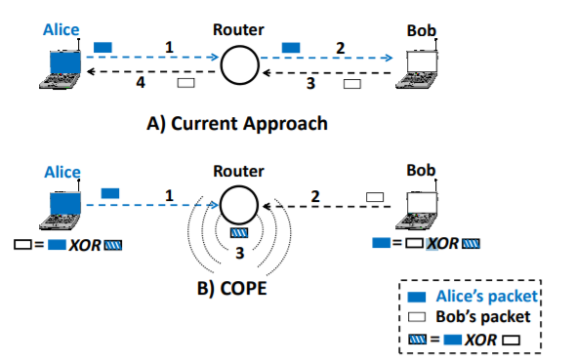
COPE: Packet-level Network Coding
It takes advantage of the broadcast nature of the wireless medium, which allow multiple nearby nodes to overhear a packet when it is broadcast from a node.

Slide 36
Analog Network Coding
Instead of avoiding interference, we exploit the interference.
Multiple senders transmit simultaneously, the packets collide.
It means that the channel adds their physical signals after applying attenuations and time shifts.
Thus if we know the content of the packet that interfered we can derieve the signal we are interested in.

Slide 37
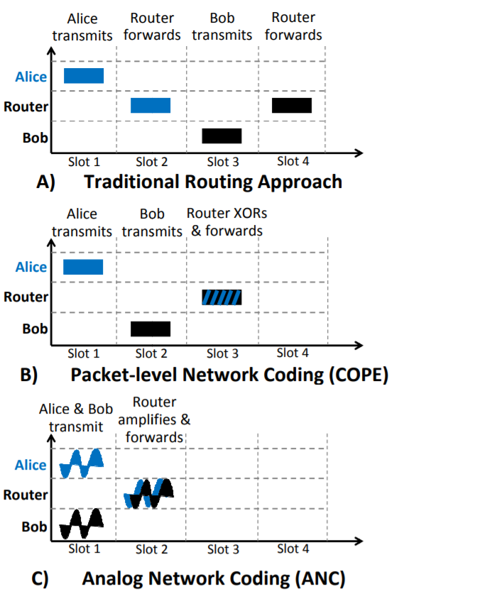

Slide 40
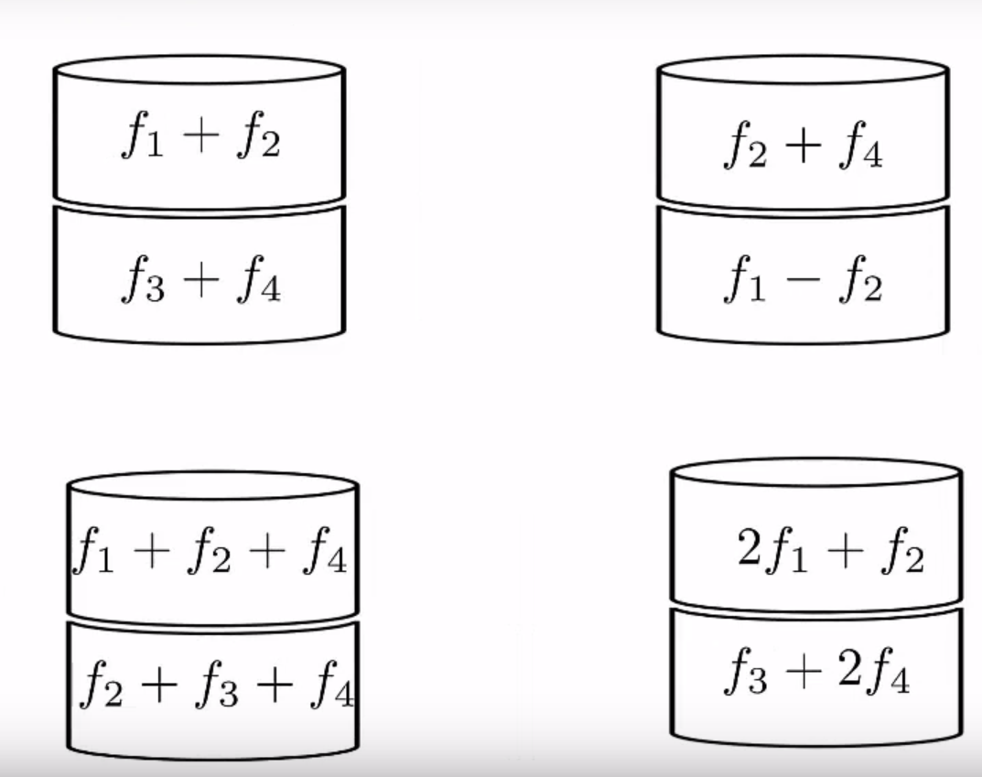
Coding For dIstributed Storage

Slide 41
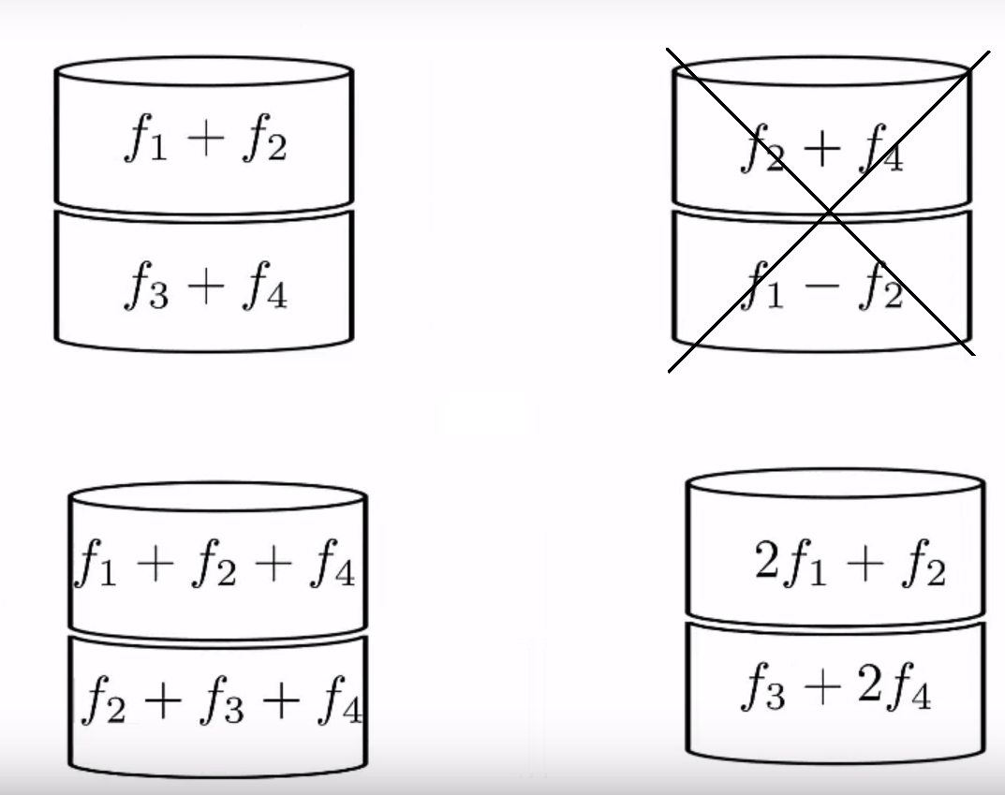
Coding For Distributed Storage

Slide 42
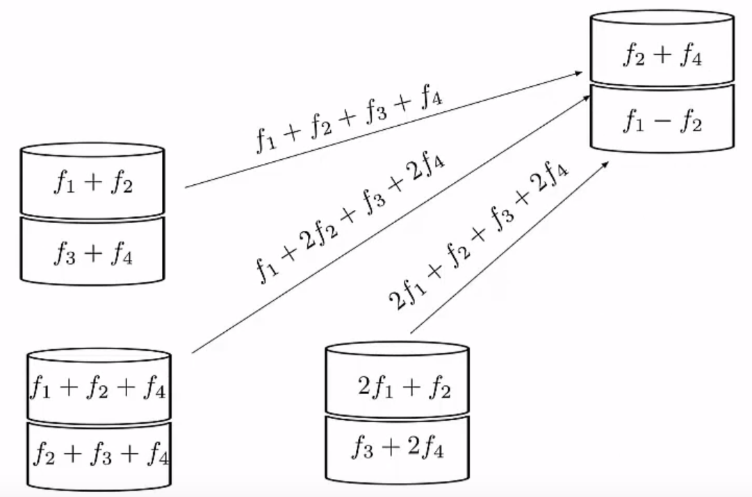
Coding For Distributed Storage

Slide 43
Areas Of Work in Network coding
No work exists that shows how to set up paths that best create coding opportunities
Previous work just shows optimization results
Once we have such distributed protocols, how do different link/node costs affect network setup decisions?

Slide 44
Network Coding In security
Network coding has been shown to improve security against many types of attacks including: eavesdropping, modifying data, and jamming attack.
Data does not exist on one node but rather is distributed, overhearing data packets will not result in getting the information except by getting all the required blocks which makes it harder for the eavesdropper
Due to data distribution we can know any piece that was changed, which prevents against modification attacks.

Slide 45
Conclusion
Network Coding is a new and promising area which is based on computer and communication network problems.
Recent work on network coding portrays a new aspect on multicast in a network.
Using network coding could help improve performance of a networks by exploiting current infrastructure.
Compared to traditional routing, Network Coding offers more benefits with respect to resource, efficiency and robustness.

Slide 46
Thank You

